Slide 1



Mobile Application Development (COS7025-B) Introduction
Karim Hammoud Sadik
Lecture #1
Android Studio
School Of Computer Science, and Engineering

Slide 2
Teaching Staff!
Module Leader
Mr. Karim Hammoud Sadik
Email: asadik@bradford.ac.uk
Office D4.09 Horton
Research/Teaching Interests:
Web link: https://www.bradford.ac.uk/staff/asadik
Availability: By appointment only

Slide 3
Learning Activities
Two sessions each week
Every Monday 11-12 Am (Lectures)
Every Tuesday 12-14 pm (Labs)
Coursework
Testing practical aspects
VLE/Canvas
Lecture notes (attendance is crucial)
Reading materials (essential)
Discussion board (please post your questions there)
School Of Computer Science, AI and Electronic

Slide 4
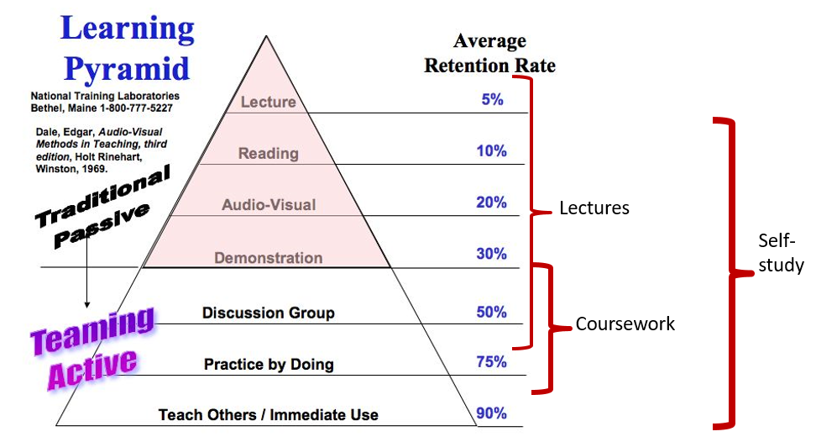
Learning Activities
Source: http://sydney.edu.au/engineering/civil/current/undergraduate/learning.shtml

Slide 5
What is this module about?
Learn about:
Mobile devices
Android Programming
Develop interesting Android applications
Expect lots of programming
Hands-on lab exercises
Module organisation
Mix of labs and lectures – soft (e.g. mobile app development roadmap, human factors) and hard skills (how to program a functional app using Android)
Lectures to cover theoretical aspects
Lab to have hands-on experience

Slide 6
Lecture (some) Topics
Introduction to Mobile Applications and Android Platform
Mobile application development roadmaps
Human factors in Mobile app development
Android Studio & Emulators
MVC in android development
Android
Activities & Fragments
Lists & Adaptors
Storage/Access using Databases and Web Services
Location API

Slide 7
Lab (some) Exercises
Java Programming
Introduction to Java + Kotlin
Installation of Android & Emulators
Development of mini-apps
Fragments (Tasks)
Web services & Cloud database (Firebase)
SQLite

Slide 8
Assessment
No written exams!!
One course work:
Mobile Application (mini) Project [100%]
Type: Report (based on development work) + Source code
Deadline – End of the year
Formative assessment [0%] – feedback on case study selection
Exact details will be available soon.

Slide 9
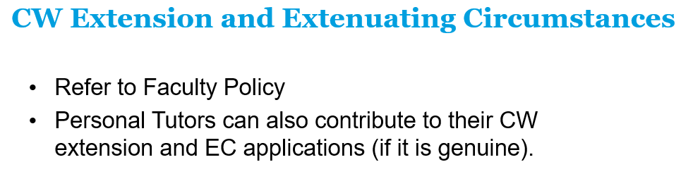
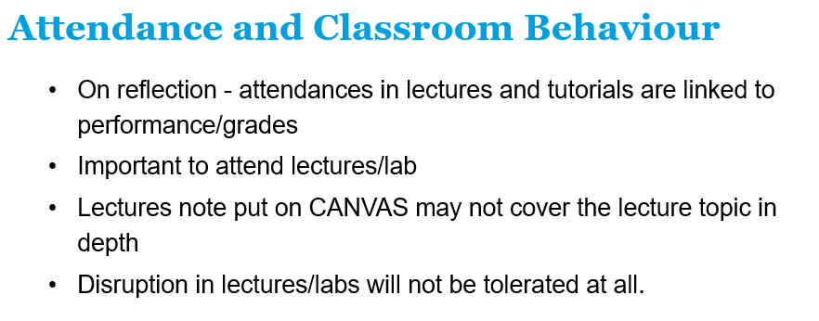
Module Policy

Slide 10
What I Expect From You
Good attendance…!
Positive questions, anecdotes and insight I may miss
Muted phones, exceptions will be given for emergencies etc or when it needs to be used for Lab exercises, you do not need one if you do not have one (or if you do not have Android one)
Be on time
A decent quality of academic writing
Standard etiquette for speech/ presenting
Utilise your 164 hours of independent study

Slide 11
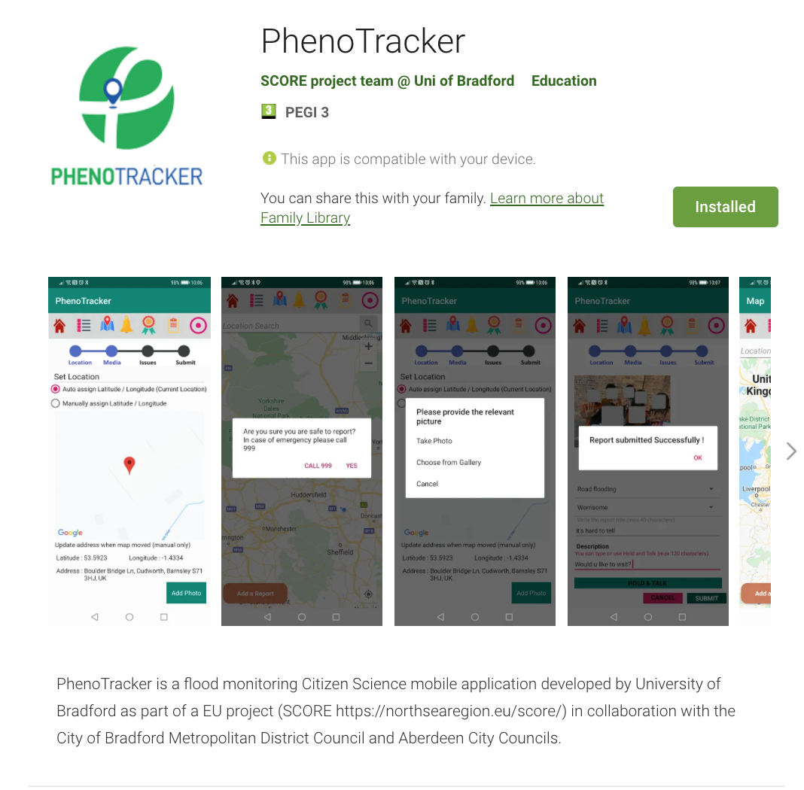
Existing Work @ Bradford
Example #1

Slide 12
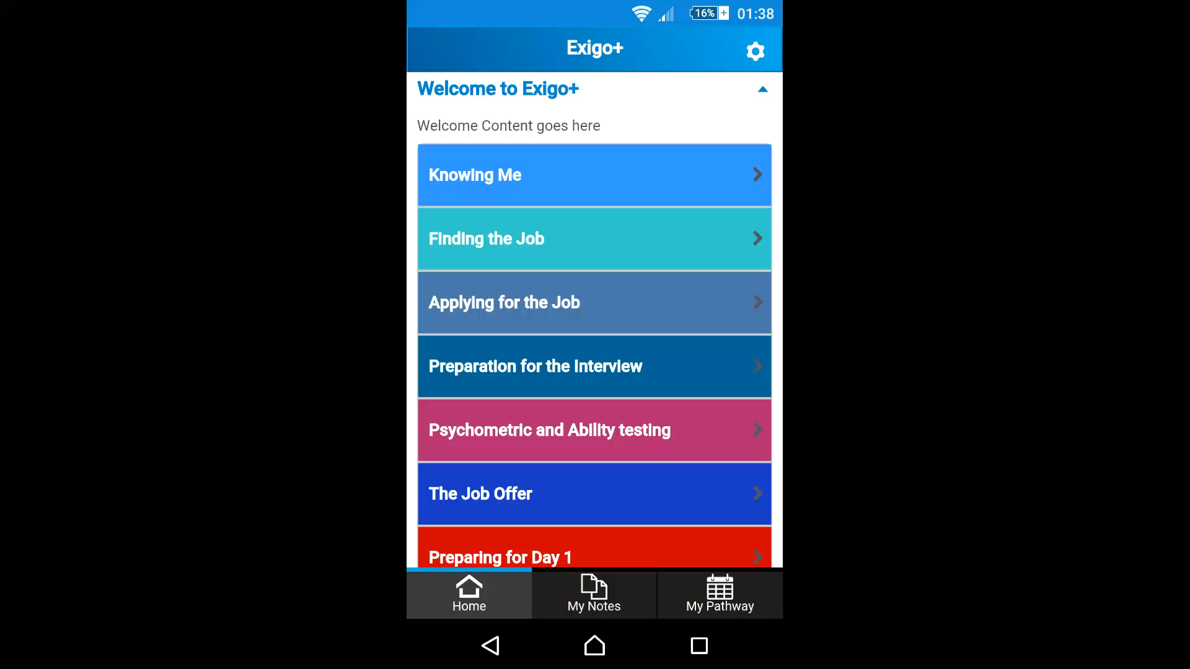
Job Application Management
Existing Work @ Bradford
App is finalised to be released through Google Play store
Example #2
Client: Exigo+; Student: Bala Chockalingam; Course: MSc Mobile Applications

Slide 13
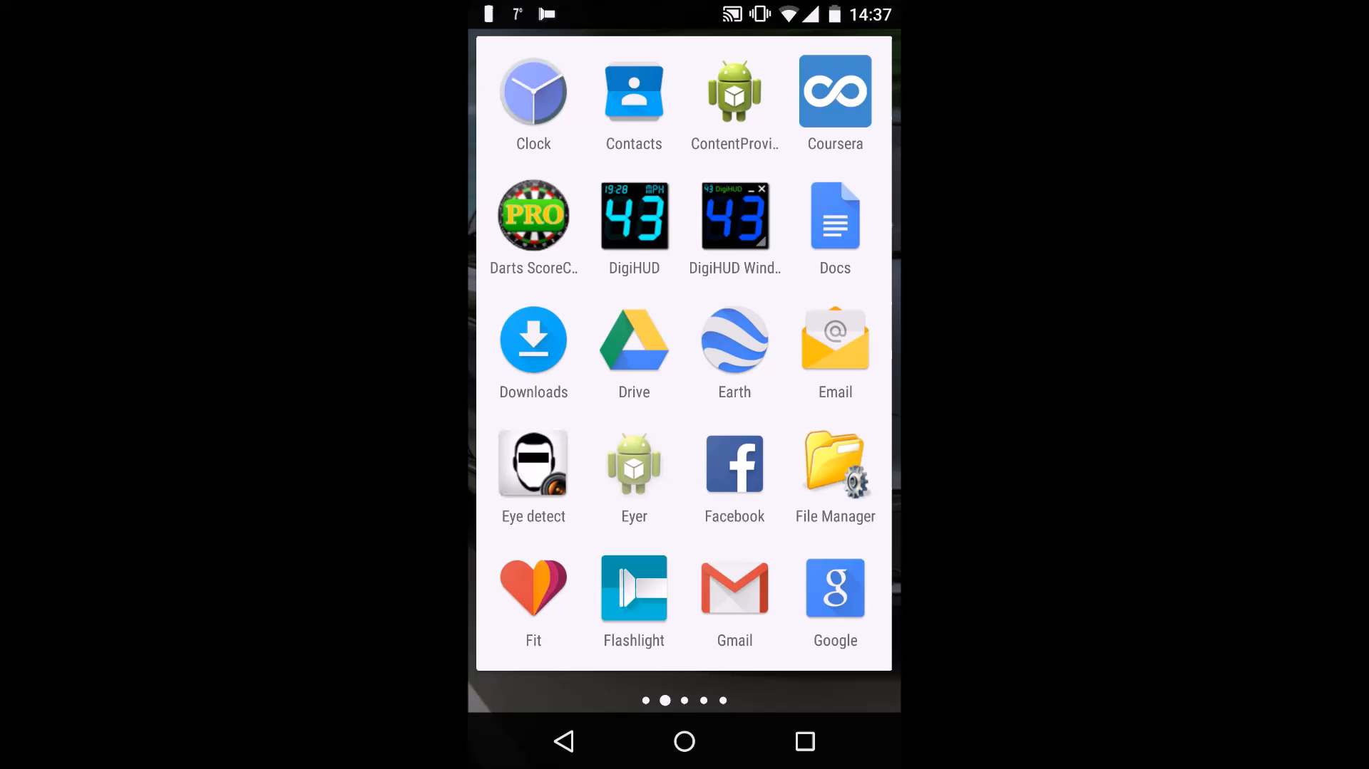
Eye Tracking Software
Existing Work @ Bradford
Example #3
Client: Division of Psychology (Bradford) and Institute of Psychological Sciences (Leeds)
Project: Eye/Pupil tracking software can be implemented and used on a tablet and/or phone device to enable recording of gaze position. Capture and store the information in an appropriate form for post-hoc analysis
School Of Computer Science, AI and Electronic

Slide 14
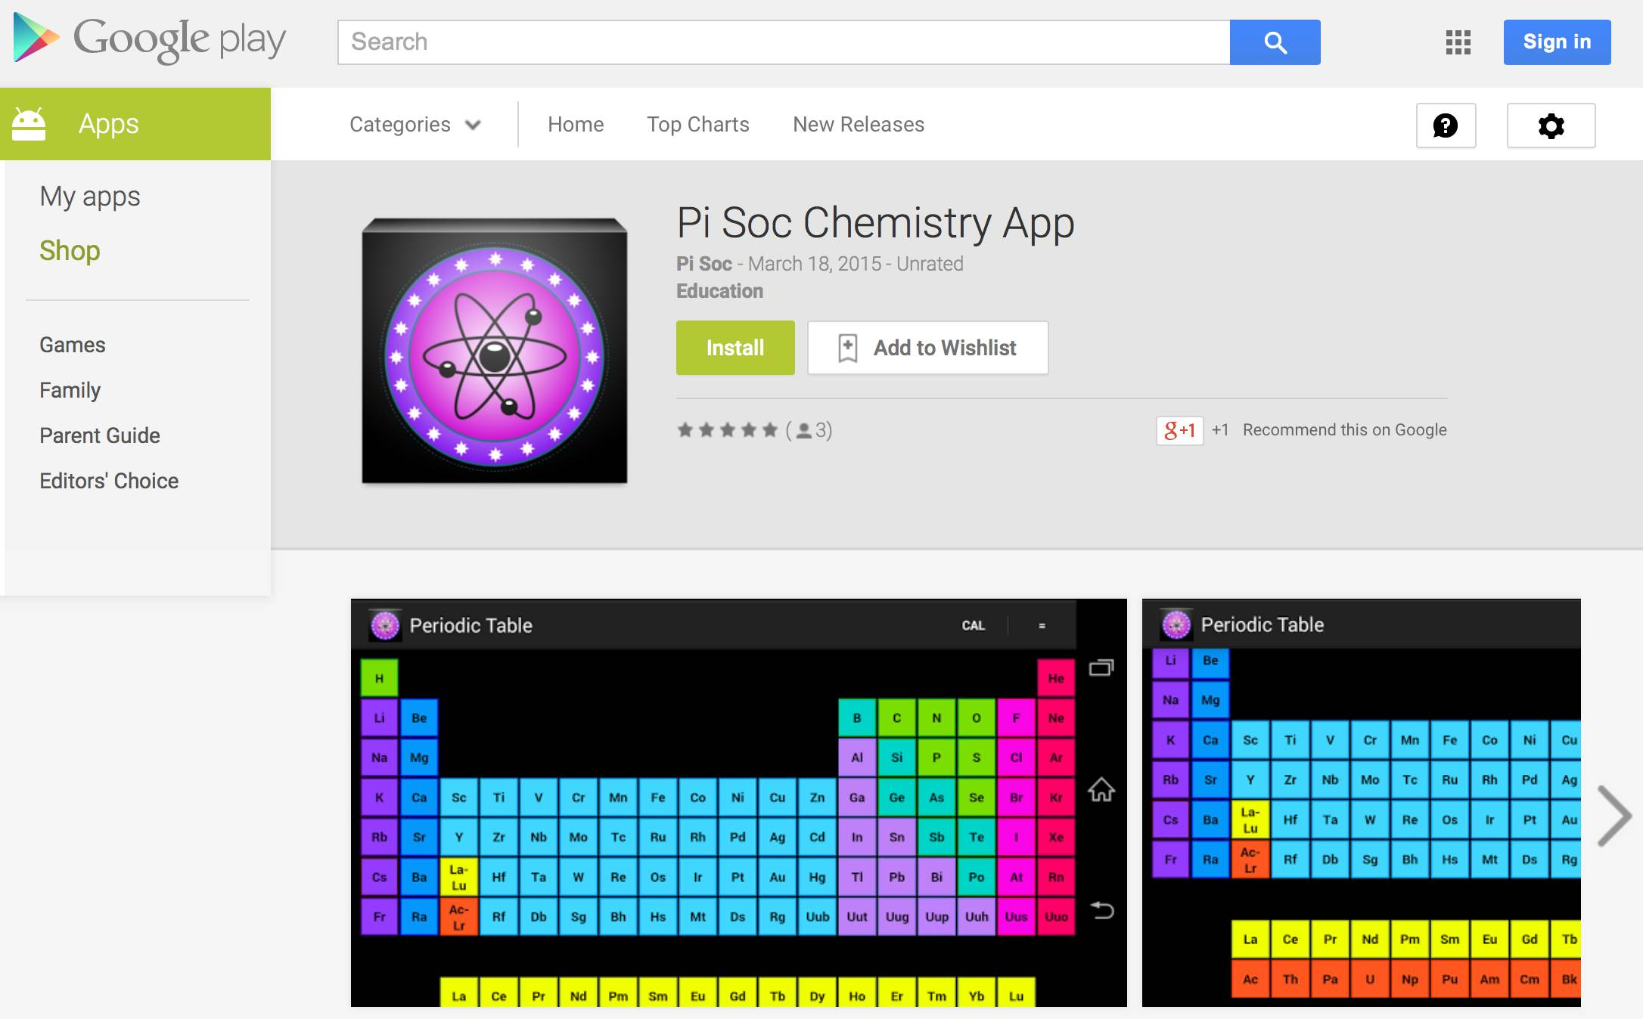
Chemistry App
Existing Work @ Bradford
Example #4
Chemistry App (designed for Chemical Forensic Society) is a cell based display of all currently known periodic elements in the style of the traditional periodic table everyone knows and loves.
Functional and interactive periodic table, complete with element statistics and an easy to use atomic mass calculator.
Features:
1) 118 Elements.
2) Atomic number, atomic mass, electron shells, symbol, and name.
3) Zoom-able periodic table.
School Of Computer Science, AI and Electronic

Slide 15
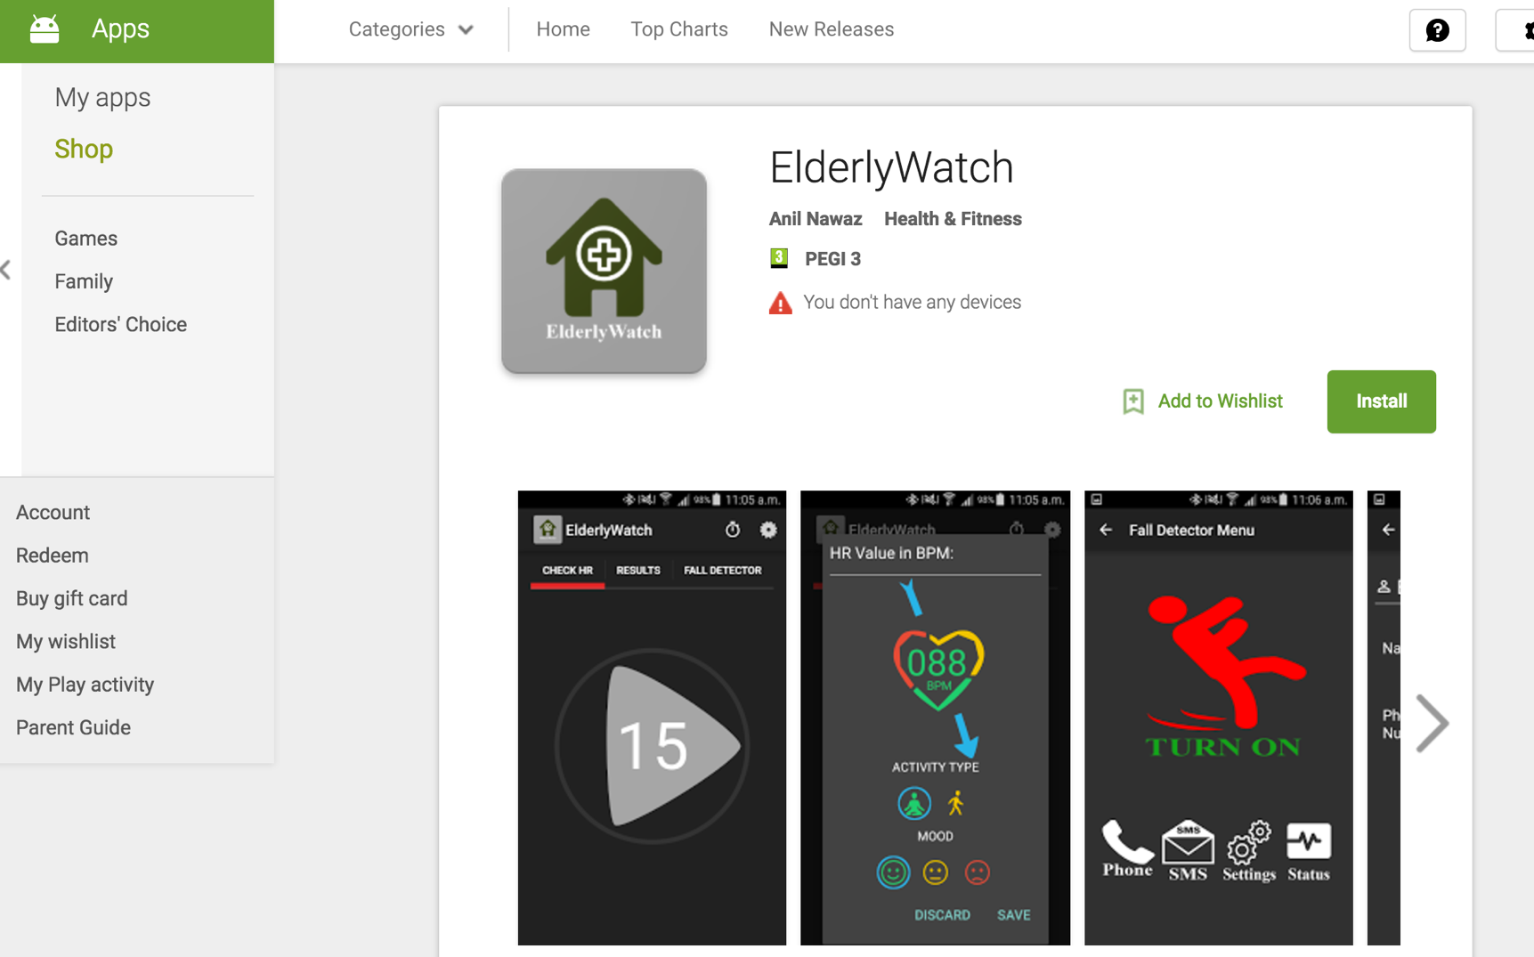
Existing Work @ Bradford
Fall Detection – Digital Health app
Example #5

Slide 16
Android Studio + Java
Android Studio + Java
Android Studio

Slide 17
Android Studio + Java
Unlike compiled languages (e.g., Pascal or C), Java uses both a compiler and an interpreter.
Compiled languages need to be re-compiled when their program needs to run on a different architecture.
Java is compiled (to java bytecode) and interpreted (by Java Virtual Machine), so any java program that’s compiled on one architecture can also run on any other architecture (as long as it has a java interpreter).
Android Studio comes bundled with OpenJDK, an open source implementation of Java, so you don’t have to install any other SDKs in order to develop.

Slide 18


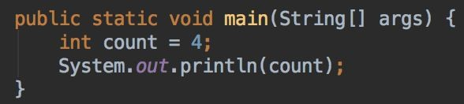
Java - Data types and variables
hello world is a literal (actual data)
count is a variable (a container for data) and int is its type (i.e., the kind of data it is)
Just like C/C++, Java has its own main method, which is the entry point into a program.
School Of Computer Science, AI and Electronic

Slide 19
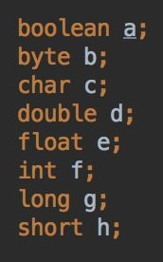
Java - Primitives
Primitives are built in data types in a programming language. The image to the left shows the primitive data types of Java. They’re the building blocks of a much more complicated data type, known as class.
For example:
String class is an array of char.
Date class can be seen as a composite of three int’s (for month, day, and year).
The variables (or fields) of a class define what sort of operations are valid on it, these operations are known as methods.

Slide 20
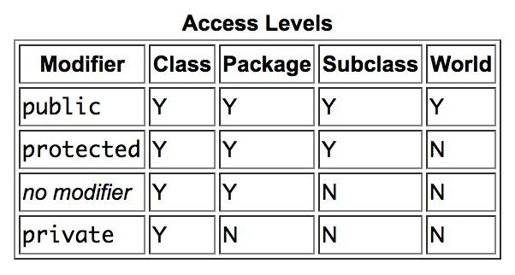
Java - access modifiers
https://docs.oracle.com/javase/tutorial/java/javaOO/accesscontrol.html
School Of Computer Science, AI and Electronic

Slide 21
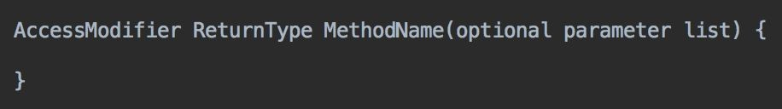
Java - methods
AccessModifier - used to control the visibility of a method
ReturnType - used to declare what type of data this method returns (void returns nothing)
MethodName - used to name the method
optional parameter list - can have 0 to n types of parameters
There is a special type of method called the constructor , which can be called when an object needs to be created using new. Java has no concept of destructor methods.

Slide 22
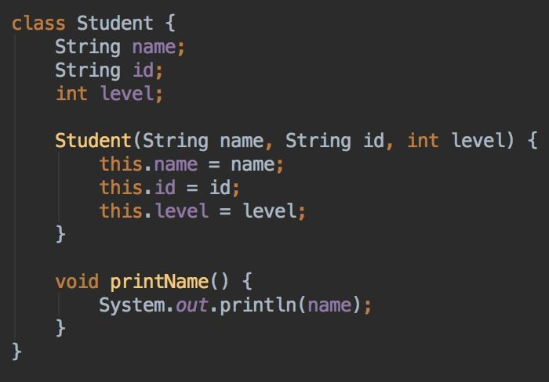
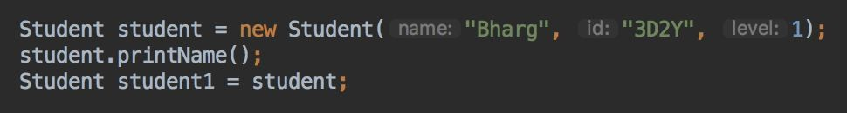
Java - class and method

Slide 23
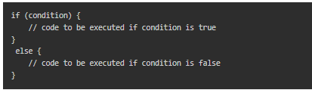

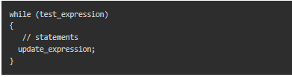

Java - conditional, iteration, and arrays
These are all really similar to how C/C++ does things, so we don’t need to go in depth.
If you’ve used any sort of these statements in another programming language, chances are you’ll pick this up in Java really easily.
if else Syntax in Java
Java for loop Syntax
Java while loop Syntax
Syntax for declaring a one-dimensional array
Syntax for declaring a multi-dimensional array

Slide 24
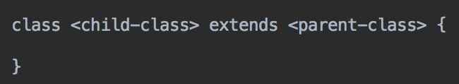
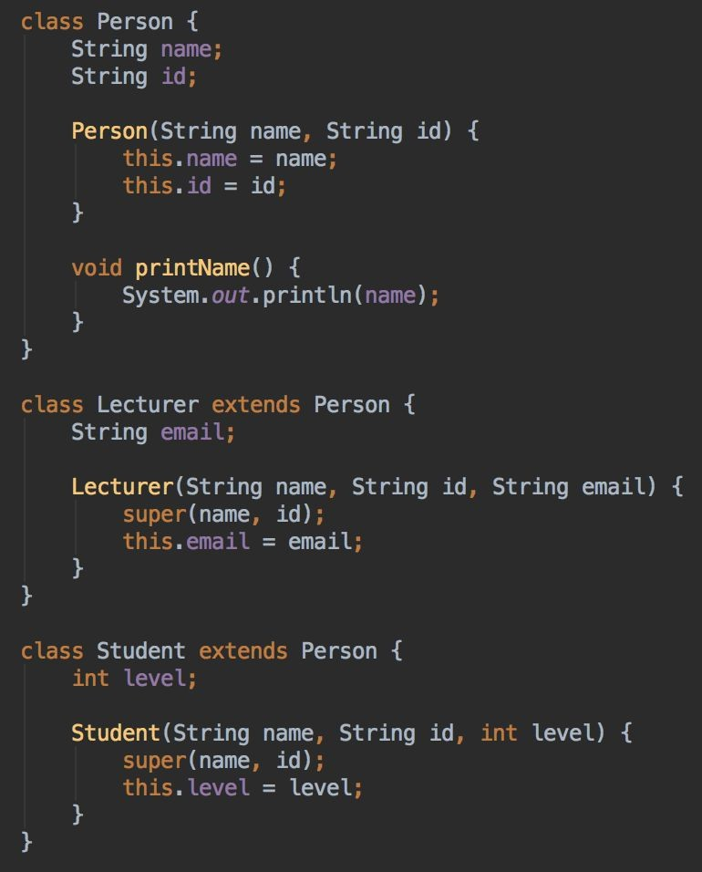
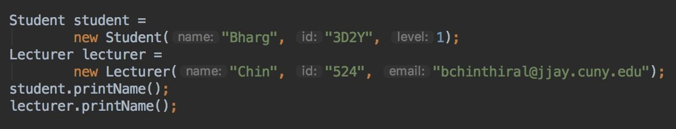
Java - inheritance
Inheritance is the process of one class inheriting the features (fields and methods) of another class
A class can only inherit from one other class
A class can be inherited by any number of classes
So, a child can have only one parent, but a parent can have many children

Slide 25
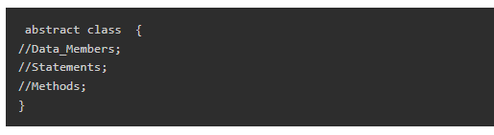
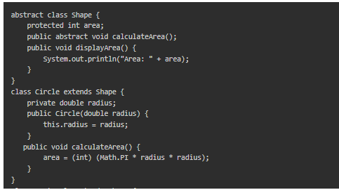

Java - abstract and interface classes
Abstract classes:
cannot be instantiated, but can contain implementation of fields and methods
can only be inherited (by using extends keyword)
This definition of abstract class
Example on how to use abstract class in java program

Slide 26
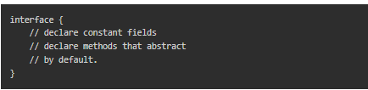

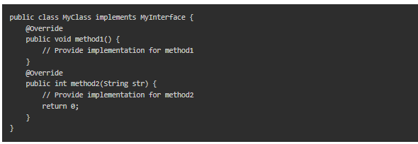
Java - abstract and interface classes
- Interface classes:
cannot be instantiated, and cannot contain any implementation details
used to specify a “contract” or “blueprint” of what methods a class can implement
can only be implemented (by using implements keyword)
Java Interface Syntax
Declare the Interface
Implement the Interface

Slide 27
Any Questions?

